Slide 1
MSRP Project: BioChem Insights Inc
Presented by
Priyanka
Yixian
Mengfang
Guided by :
Clifford Morrison
Oct 5, 2016

Slide 2
What is the problem?
Drinking water and water used for agriculture is polluted by nitrate in North America
What is nitrate?
Nitrates occur when nitrogen combine with organic elements like ammonia to form invisible tasteless compound.
Why is it so bad?
Effects on humans
Effects on environment
What are the major causes?
Agriculture (fertilizer and animal manure)
Human waste

Slide 3
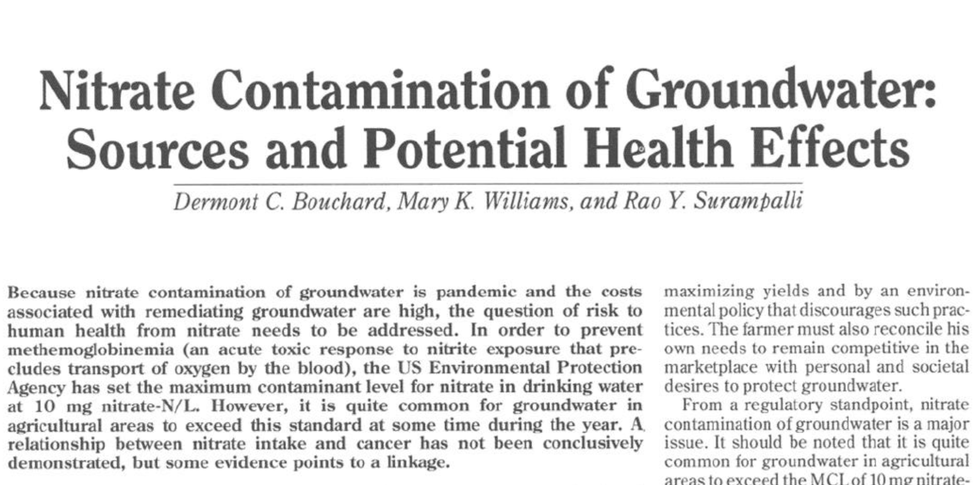
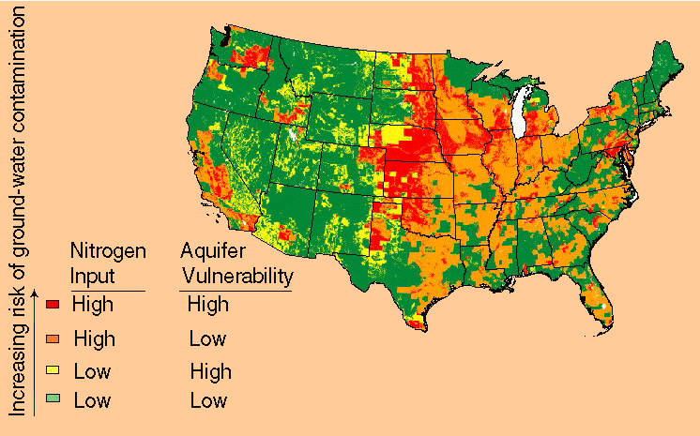
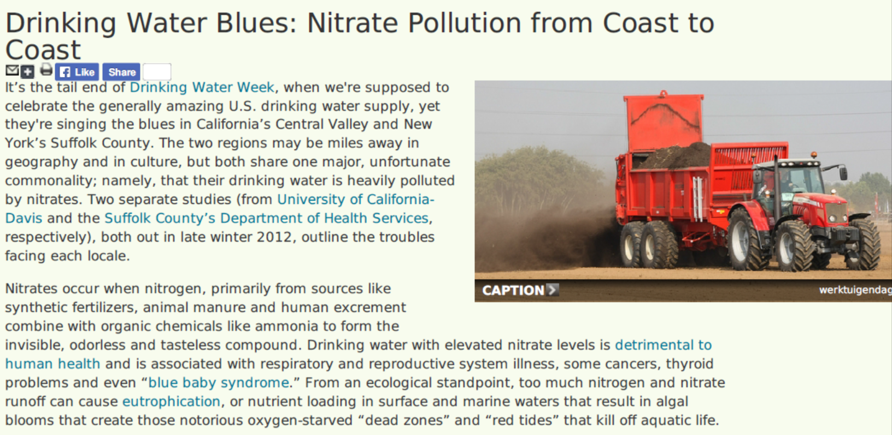
Why is it important to focus on this problem?
http://water.usgs.gov/nawqa/nutrients/pubs/wcp_v39_no12/

Slide 4
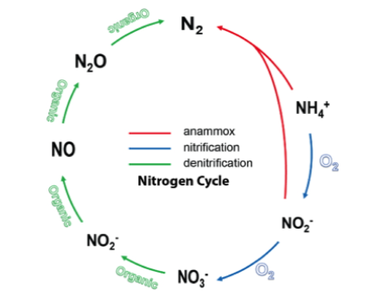
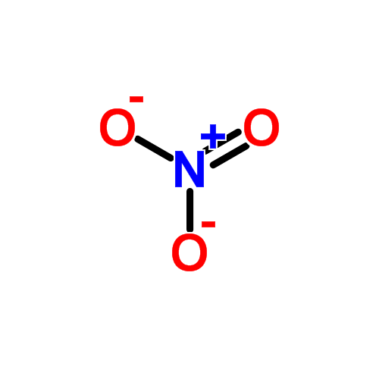
What is the plan to resolve the problem?
Biological Denitrification
utilization of an electrochemical bioreactor to provide reducing power for denitrifying bacteria to convert harmful nitrates into harmless atmospheric nitrogen
The method: Bio-electro reactors.

Slide 5
Our responsibilities & Course of action
Responsibilities:
Case studies, assess the value, economic impact of the technology
Directed market research to assess the market size
Identify local, state, national funding sources for product development
Course of action:
Technology
Data collection
Competitors in market
Case studies (NY Suffolk County & CA Central Valley) for target market
Identify advantages of using product against other alternatives
Identify cost of shutting down wells against the usage of product
Dollar to dollar impact of technology
Cost of production & installation, profit margin of using the technology

Slide 6
What are the challenges we have faced till now?
Data collection
Outdated data. No access to relevant data.
Detection of nitrate – expensive business.

Slide 7
What are the steps carried out by us till now?
Clifford Morrison, a PhD student
Dr. Bill Armiger, the President/CEO of BioChemInsights, Inc.
Michael R Kelly, the IBM senior Research Scientist.
Michael R Kelly connected Dr. Jim Sutherland and Chris Navitsky, NYS Department of environment conservation.
Prof. Faye Duchin
Prof. John Goudy in the department of economics
Prof. Sandra Nierzwicki Bauer
Ignas Gaska

Slide 8
Future actions items
Looking for the companies that are involved in detection and cleaning of the nitrates in the water.
Reading various technical reports related to nitrate contamination in drinking water.
Getting in touch with government agencies related to drinking water contamination.

Slide 9
References:
http://www.ewg.org/research/pouring-it/nitrogen-use-and-sources-nitrate-contamination
http://water.usgs.gov/nawqa/nutrients/pubs/wcp_v39_no12/

Slide 10
Q&A Thank you!

